Slide 1



Slide 2
Go to:
https://www.hertford.ox.ac.uk/unsungscience/videos
and pick a scientist!

Slide 3
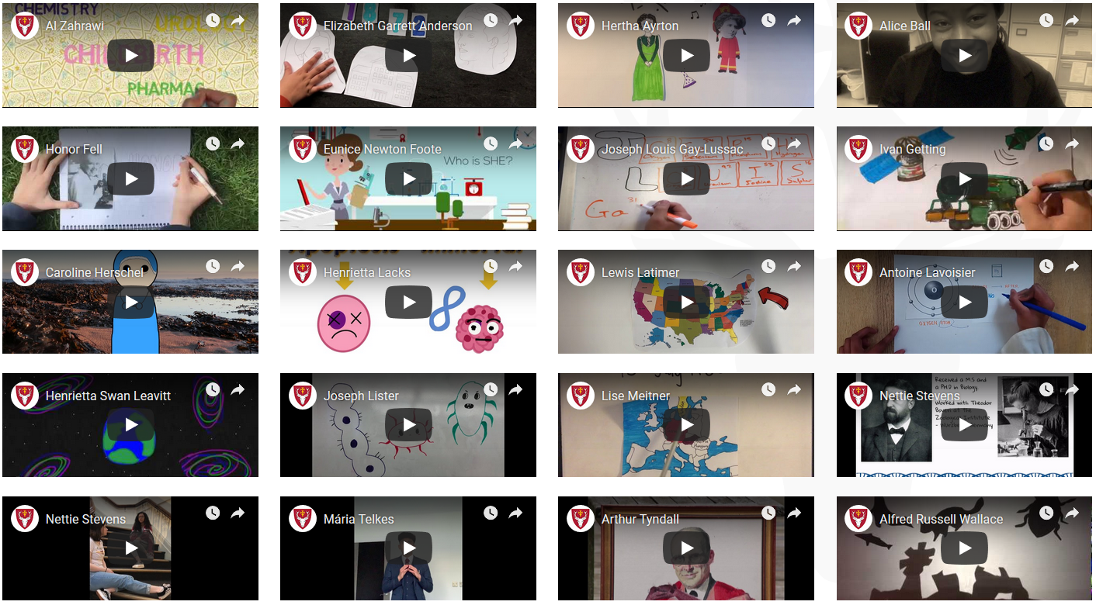

Slide 4
What century did they live and work in?
What scientific field(s) did they work in?

Slide 5
What were their achievements?

Slide 6
Had you heard of this scientist before?

Slide 7
Would you class them as an ‘unsung hero’?
Why / why not?

Slide 8
Why were / are they unrecognised
or under-appreciated?

Slide 9
Food for thought:
What has changed since then?
What hasn’t?

